Slide 1
API Probe LLM Fuzzer for RESTful Web Services
Owen Haynes

Slide 2
Motivation
Traditional tests assume predictable input behavior.
Real systems receive malformed or adversarial requests.
Unexpected inputs reveal vulnerabilities missed by normal tests.

Slide 3
Problem Statement
Traditional API tests validate only expected behavior.
Manually enumerating malformed or adversarial cases is time-consuming.
How do we go beyond traditional developer written unit tests to reach the edge case behaviors uncovered by the API Probe?

Slide 4
System Overview
LLM mutates valid API examples into adversarial variations.
Bash probe executes tests using cURL and jq.
System logs status codes and responses for analysis.

Slide 5
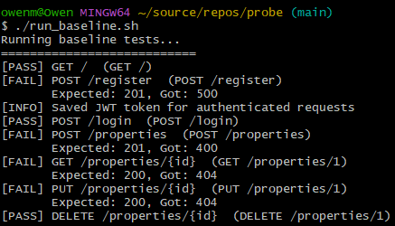
Baseline JSON Suite

Slide 6
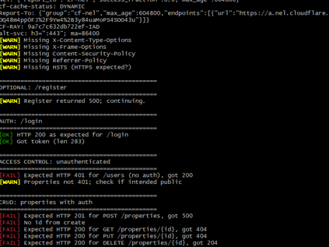

Slide 7
Experimental Design
Both test suites run on the same API instance.
Metrics compared: requests, endpoints, failures, crashes.
Additional checks: HTTP correctness, validation robustness, authentication and authorization integrity.

Slide 8
Quantitative Comparison
Metric | Baseline | LLM Probe
Requests | 7 | 180
Endpoints Reached | 7 | 22
Unique Failures | 3 | 18
Crashes (500s) | 2 | 6
Wrong Status Codes | 1 | 7
Auth Weaknesses | 0 | 3
IDOR | 0 | 1
Validation Errors | 0 | 4

Slide 9
Key Failures Found
Unauthorized access accepted in multiple cases.
SQL-like and traversal strings bypassed validation.
Incorrect or misleading HTTP status codes.

Slide 10
Interpretation
Baseline tests find functional correctness issues.
LLM probe exposes robustness and security failures.
Both approaches complement each other for complete coverage.

Slide 11
Conclusion
LLM-driven fuzzing expands the explored input space.
Reveals vulnerabilities unseen by traditional tests.

